Slide 1
The “Logically Concurrent” Issue
MPI Forum Dec 2021 – Dan Holmes/HACC WG
(now with comments from & after the meeting)

Slide 2
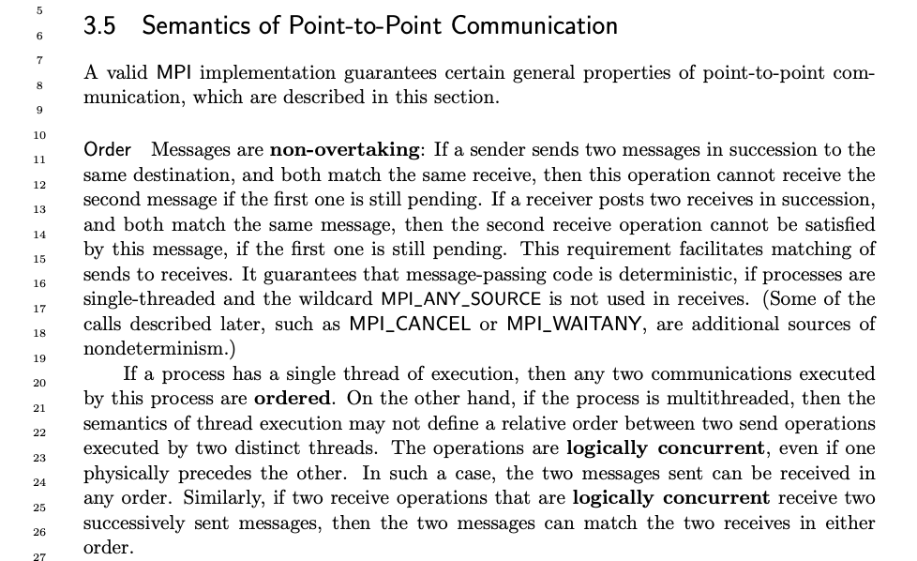
Where is the problem?

Slide 3
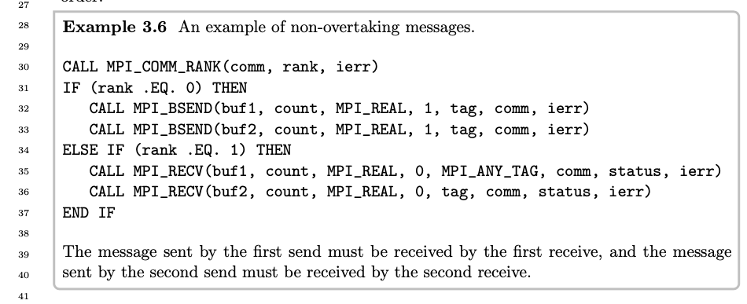
Single-threaded example

Slide 4
What about matching rules?
There is no debate about the meaning of matching rules
If using different communicators, then there is no ambiguity
If using different explicit tag values at the receiver, then there is no ambiguity
If using different source or dest, then there is no ambiguity
There is no debate about the (single-threaded) example code
If both MPI calls a made from the same thread, then there is no ambiguity
If the thread support level is MPI_THREAD_SINGLE or MPI_THREAD_FUNNELED, then there is no ambiguity

Slide 5
Multi-threaded example(s)
Missing

Slide 6
Let’s fix that oversight

Slide 7
Multi-threaded example (1st try)
CALL MPI_COMM_RANK(comm, rank, ierr) IF (rank .EQ. 0) THEN !$OMP PARALLEL DEFAULT(SHARED) THREADPRIVATE(tid, ierr) NUM_THREADS(2) !$ tid = OMP_get_thread_num() !$ IF (tid .EQ. 0) THEN CALL MPI_BSEND(buf1, count, MPI_REAL, 1, tag, comm, ierr) !$ ELSEIF (tid .EQ. 1) THEN CALL MPI_BSEND(buf2, count, MPI_REAL, 1, tag, comm, ierr) !$ ENDIF !$OMP END PARALLEL ELSEIF (rank .EQ. 1) THEN CALL MPI_RECV(buf1, count, MPI_REAL, 0, MPI_ANY_TAG, comm, status, ierr) CALL MPI_RECV(buf2, count, MPI_REAL, 0, tag, comm, status, ierr) END IF

Slide 8
First try — notes
This code requires MPI_THREAD_MULTIPLE
No synchronisation between threads, concurrent execution
“Semantics of thread execution [do] not define a relative order”
Which send happens first? Which send happens second?
This code does not match the single-threaded example
From a process-centric point-of-view
This formulation does not cover all multi-threaded cases/situations
What about multi-threaded but not MPI_THREAD_MULTIPLE?

Slide 9
Multi-threaded example (2nd try)
CALL MPI_COMM_RANK(comm, rank, ierr) IF (rank .EQ. 0) THEN !$OMP PARALLEL DEFAULT(SHARED) THREADPRIVATE(tid, ierr) NUM_THREADS(2) !$ tid = OMP_get_thread_num() !$OMP CRITICAL !$ IF (tid .EQ. 0) THEN CALL MPI_BSEND(buf1, count, MPI_REAL, 1, tag, comm, ierr) !$ ELSEIF (tid .EQ. 1) THEN CALL MPI_BSEND(buf2, count, MPI_REAL, 1, tag, comm, ierr) !$ ENDIF !$OMP END CRITICAL !$OMP END PARALLEL ELSEIF (rank .EQ. 1) THEN CALL MPI_RECV(buf1, count, MPI_REAL, 0, MPI_ANY_TAG, comm, status, ierr) CALL MPI_RECV(buf2, count, MPI_REAL, 0, tag, comm, status, ierr) END IF

Slide 10
Second try — notes
This code requires at least MPI_THREAD_SERIALISED
Synchronisation between threads prevents concurrent execution
“Semantics of thread execution [do] not define a relative order”
Which send happens first? Which send happens second?
This code does not match the single-threaded example
From a process-centric point-of-view

Slide 11
Multi-threaded example (3rd try)
CALL MPI_COMM_RANK(comm, rank, ierr) IF (rank .EQ. 0) THEN !$OMP PARALLEL DEFAULT(SHARED) THREADPRIVATE(tid, ierr) NUM_THREADS(2) !$ tid = OMP_get_thread_num() !$ IF (tid .EQ. 0) THEN CALL MPI_BSEND(buf1, count, MPI_REAL, 1, tag, comm, ierr) !$ ENDIF !$OMP BARRIER !$ IF (tid .EQ. 1) THEN CALL MPI_BSEND(buf2, count, MPI_REAL, 1, tag, comm, ierr) !$ ENDIF !$OMP END PARALLEL ELSEIF (rank .EQ. 1) THEN CALL MPI_RECV(buf1, count, MPI_REAL, 0, MPI_ANY_TAG, comm, status, ierr) CALL MPI_RECV(buf2, count, MPI_REAL, 0, tag, comm, status, ierr) END IF

Slide 12
Third try — notes
This code requires at least MPI_THREAD_SERIALISED
Synchronisation between threads prevents concurrent execution
Semantics of thread execution DO define a relative order
We know for certain which send happens first/second
This code DOES match the single-threaded example
From a process-centric point-of-view
We should get the same result as the single-threaded example
Right?

Slide 13
What could go wrong?

Slide 14
What did the programmer intend?
In the third try, the OMP BARRIER shows clear programmer intent
The message from the thread where (tid.EQ.0) must “go first”
Presumed intent: the first message will not overtake the second
In the first and second tries, there is no clear programmer intent
From the user’s point-of-view, either message could “go first”
Presumed intent: whatever is fastest/best for MPI?

Slide 15
What about thread support levels?
Up to MPI_THREAD_SERIALIZED tells MPI there must be an order
In the first try, these thread support levels are erroneous
These levels mean MPI knows there is an execution order
Whether the programmer knows it or not
MPI will definitely “see” one MPI call before the other
MPI_THREAD_MULTIPLE tells MPI nothing about order
MPI might “see” one MPI call before the other ...
… or execution of the two MPI calls might be interleaved

Slide 16
How can MPI tell the difference?
MPI cannot “see” the OpenMP BARRIER
Also, what about other forms of synchronisation?
MPI cannot distinguish forced synchronisation from accidental timing
sleep(1000) or load imbalance look the same to MPI
Insight: these three codes are ONE and the SAME example
(When using MPI_THREAD_MULTIPLE for all three)

Slide 17
What about thread compliance?
Section 11.6.1 “1. All MPI calls are thread-safe, i.e., two concurrently running threads may make MPI calls and the outcome will be as if the calls executed in some order, even if their execution is interleaved.”
For thread-compliant MPI implementations, even if the actual execution is interleaved (so, no defined relative execution order), there must be an “outcome order” (as if there was a relative execution order)

Slide 18
What about performance optimisations?
Code to determine timing, which thread/call is “first”?
Clocks — system call, bad
Locks — reduced parallelism, ugly
Atomics — near-zero overhead, good enough?
Code to transmit order/sequence — needed anyway
For example, single-threaded code but adaptively routed network

Slide 19
What about user-level threads?
New
Can MPI reliably distinguish between different “threads”?
Can MPI reliably identify which “thread” is calling into MPI?
Can MPI reliably protect its internal data structures from “threads”?
Does support for “threads” require integration with the (user-level) threading library/runtime?
Does support for multiple types of “thread” require integration with multiple threading libraries/runtimes?
Does this create a combinatorial build problem?

Slide 20
A little from camp A A little from camp B

Slide 21

Camp A — “I will have order” (Dolores Umbridge)
There is always a relative order for MPI calls
Also, an ordering can always be imposed
Parallel programming is hard enough as it is!
When the order is clear, MPI must not disobey

Slide 22

Camp B — “Freedom!” (William Wallace)
MPI cannot differentiate forced from accidental
Determining programmer intent is impossible for MPI
Imposing and/or enforcing order costs performance
There are better ways to achieve order, e.g. tags

Slide 23
What can we do?

Slide 24
Tentative proposal(s)
Modify the definition of the overtaking rule to clearly state camp A/B
There is no consensus on which camp to choose
Both break something we don’t want to break <- bad
Create new thread support levels
Camp A is between MPI_THREAD_SERIALIZED and MPI_THREAD_MULTIPLE
Camp B is greater than MPI_THREAD_MULTIPLE
MPI_THREAD_MULTIPLE is left alone — still ambiguous
New thread support levels are only permitted for sessions

Slide 25
16%
Questions?

Slide 26
What about the receiver-side?
New
We need a detailed treatment of the receive-side for the multithreaded sender (with single-threaded receiver) example codes.
Walk through all the ways to insert/remove items in the receiver’s “queue”
Decide required/permitted/prohibited for each (with Standard references)
We need a detailed treatment of both sides of a multithreaded receiver (with single-threaded sender) example code.
Matching must be done by the receiver MPI process; does that change things significantly? If so, why and how?
We need a detailed treatment of both sides of a multithreaded sender & multithreaded receiver example code.

Slide 27
Which camp is right?
New
We need to lead the discussion away from “which camp is right?”
We should discover the pros and cons for choosing each approach.
We should discuss ways to offer both approaches in future.

